Slide 1

EEI4346 Web Technology Day School 01
H.R.S.Senanayake
Email: hrsen@ou.ac.lk CITES Faculty of Engineering Technology The Open University of Sri Lanka

Slide 2

Content
HTML5
Vue
Ajax
Client-Side Programming
Department of……………………………

Slide 3
HTML5
Department of……………………………

Slide 4
HTML
HTML stands for Hyper Text Markup Language
HTML is the standard markup language for creating Web pages
HTML describes the structure of a Web page
HTML consists of a series of elements
HTML5 is the latest and most enhanced version of HTML
Department of……………………………

Slide 5
HTML5 - Syntax
DOCTYPE
- The <!DOCTYPE html> declaration represents the document type and helps browsers to display web pages correctly.
Character Encoding
- A method of converting bytes into characters. To validate or display an HTML document properly, a program must choose a proper character encoding.
<meta charset=“UTF-8”>
Script
- It's common practice to add a type attribute with a value of "text/javascript" to script, but in HTML5 removes extra information required
<script src=“app.js”></script>
Department of……………………………

Slide 6
Link
- It's common practice to add a type attribute with a value of "text/css" to link, but in HTML5 removes extra information required
<link rel =“stylesheet” href=“style.css”>
HTML5 Elements
-HTML5 elements are marked up using start tags and end tags. Tags are delimited using angle brackets with the tag name in between.
<p> My Paragraph </p>
HTML5 Attributes
- Elements may contain attributes that are used to set various properties of an elements.
<div class=“app”>………</div>
Department of……………………………

Slide 7
Table
- The <table> tag defines an HTML table. Each table row is defined with a <tr> tag. Each table header is defined with a <th> tag. Each table data/cell is defined with a <td> tag
<table>
<tr>
<th> Name</th>
<th> Address</th>
</tr>
<tr>
<td> Amali</td>
<td> Colombo</td>
</tr>
<tr>
<td> Kamal</td>
<td> Galle</td>
</tr>
</table>
Department of……………………………

Slide 8
Form
- An HTML form is used to collect user input. The user input is most often sent to a server for processing.
<form action=“#”>
<label for=“fname”> First Name:= </lable>
<input type=“text” id=“fname” >
<label for=“gender”> Gender:= </lable>
<input type=“radio” name=“gender” value=“male”>Male
<input type=“radio” name=“gender” value=“female”>Female
<label for=“terms”> Terms:= </lable>
<input type=“checkbox” name=“terms”>
<input type=“button” value=“SUBMIT”>
</form>
Department of……………………………

Slide 9
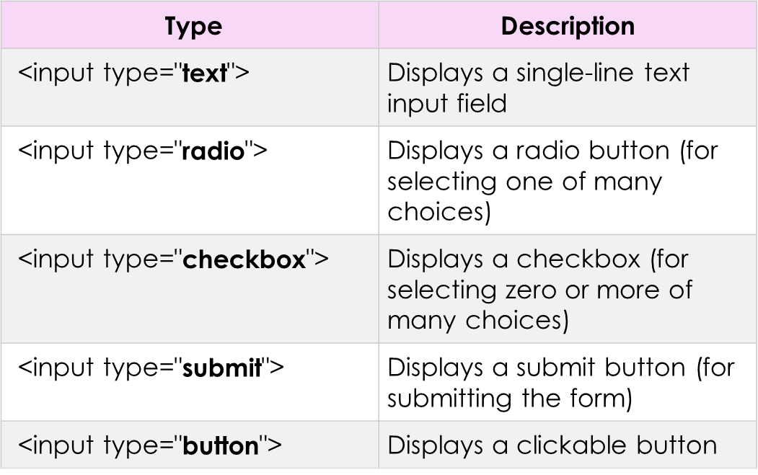
Form
Department of……………………………

Slide 10
HTML5 - Document
section − This tag represents a generic document or application section. It can be used together with h1-h6 to indicate the document structure.
article − This tag represents an independent piece of content of a document, such as a blog entry or newspaper article.
aside − This tag represents a piece of content that is only slightly related to the rest of the page.
header − This tag represents the header of a section.
footer − This tag represents a footer for a section and can contain information about the author, copyright information, et cetera.
nav − This tag represents a section of the document intended for navigation.
Department of……………………………

Slide 11
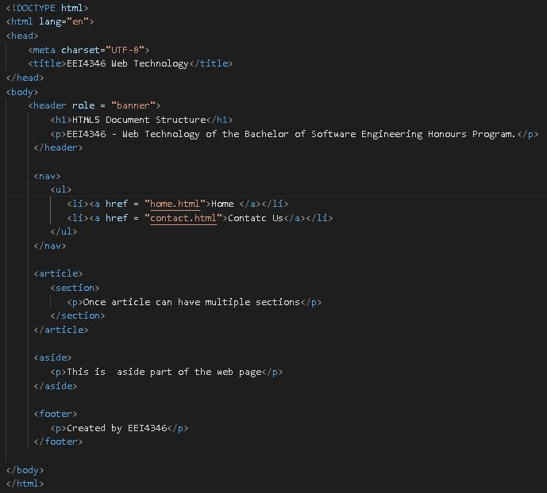
Department of……………………………

Slide 12
VUE JS
Department of……………………………

Slide 13
Introduction
Vue is a progressive framework for building user interfaces
Progressive framework is a framework that you can insert into your project as you feel the need for it.
Frontend JavaScript/ typescript framework
The core library is focused on the view layer only, and is easy to pick up and integrate with other libraries or existing projects
Vue is simpler and more flexible
Vue allows you make just specific parts of your application. You learn just what is necessary for the problem you are dealing with.
Department of……………………………

Slide 14
Installation
There are three primary ways to add Vue js to the project
- Import it as a CDN package on the page
<script src="https://unpkg.com/vue@next"></script>
- Install it using npm
$ npm install vue@next
- Use the official CLI to scaffold a project
npm install -g @vue/cli
Department of……………………………

Slide 15
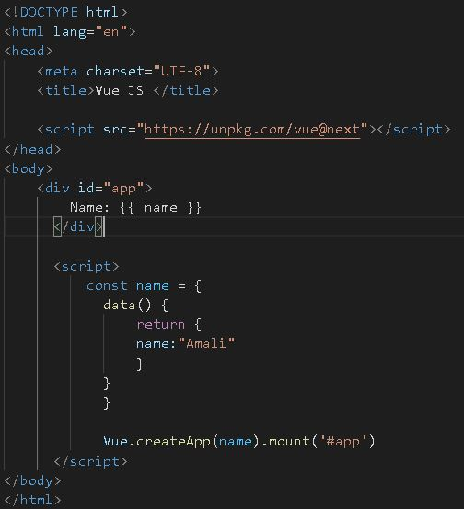
Department of……………………………

Slide 16
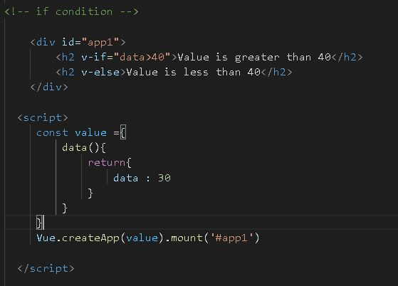
Department of……………………………

Slide 17
AJAX
Department of……………………………

Slide 18
Ajax stands for Asynchronous JavaScript and XML
Ajax is a web development technique used to create interactive and dynamic web applications
Ajax is not a programming language or a technology itself, but a combination of existing technologies
It enables asynchronous communication between the browser and the server without reloading the entire web page
Ajax allows updating parts of a web page with new data, improving user experience and responsiveness
Watch Me
Department of……………………………

Slide 19
How Does Ajax Work?
Ajax uses a combination of JavaScript, XML (or JSON), and XMLHttpRequest object
JavaScript is used to make asynchronous requests to the server
XMLHttpRequest object is responsible for handling the communication with the server
XML or JSON is commonly used to format the data sent and received between the browser and the server
Department of……………………………

Slide 20
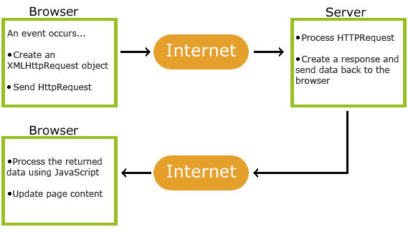
1. An event occurs in a web page (the page is loaded; a button is clicked)
2. An XMLHttpRequest object is created by JavaScript
3. The XMLHttpRequest object sends a request to a web server
4. The server processes the request
5. The server sends a response back to the web page
6. The response is read by JavaScript
7. Proper action (like page update) is performed by JavaScript
Department of……………………………

Slide 21
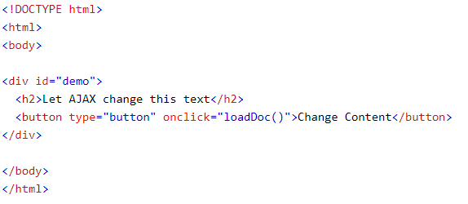
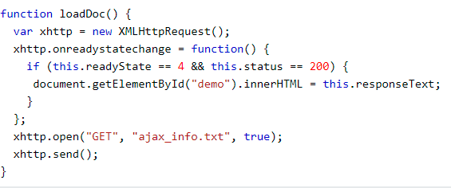
Department of……………………………

Slide 22

AJAX - Send a Request To a Server
The XMLHttpRequest object is used to exchange data with a server.
To send a request to a server, we use the open() and send() methods of the XMLHttpRequest object:
Method | Description
open(method, url, async) | Specifies the type of request method: the type of request: GET or POST url: the server (file) location async: true (asynchronous) or false (synchronous)
send() | Sends the request to the server (used for GET)
send(string) | Sends the request to the server (used for POST)
Department of……………………………

Slide 23


GET is simpler and faster than POST, and can be used in most cases.
However, always use POST requests when:
A cached file is not an option (update a file or database on the server).
Sending a large amount of data to the server (POST has no size limitations).
Sending user input (which can contain unknown characters), POST is more robust and secure than GET.
Department of……………………………

Slide 24
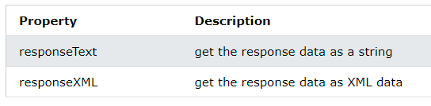
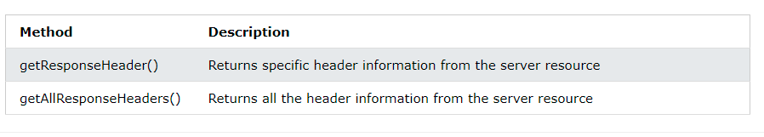
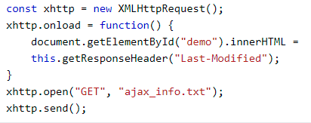
AJAX - Server Response
Department of……………………………

Slide 25
HTTP Status Codes
This is a list of Hypertext Transfer Protocol (HTTP) response status codes. Status codes are issued by a server in response to a client's request made to the server.
HTTP status codes are standard response codes given by web site servers on the internet. The codes help identify the cause of the problem when a web page or other resource does not load properly
When implementing the HTTP status code, we should apply at least three codes:
- 200 - OK (all is good)
- 400 - Bad Request (the client did something wrong)
- 500 - Internal Server Error (the API did something wrong)
- Here is the Full List
Department of……………………………

Slide 26
Advantages of AJAX
Enhanced User Experience: Ajax allows updating parts of a web page without reloading the entire page, providing a smoother and more interactive experience for users
Improved Performance: With Ajax, only the necessary data is sent and received, reducing bandwidth usage and improving application performance
Asynchronous Requests: Ajax enables asynchronous requests, so multiple requests can be made simultaneously without blocking the user interface
Ajax can be used in various scenarios, such as:
Form Submission: Submitting form data to the server without refreshing the page
Live Search: Fetching search results as the user types, without reloading the search page
Dynamic Content Loading: Loading new content into a page without refreshing, e.g., infinite scrolling or loading comments
Department of……………………………

Slide 27
Client-Side Programming
Department of……………………………

Slide 28
What is client-side script
A client-side script is a program that is processed within the client browser.
These kinds of scripts are small programs which are downloaded, compiled and run by the browser.
JavaScript is an important client-side scripting language and widely used in dynamic websites.
The script can be embedded within the HTML or stored in an external file

Slide 29
Interact with temporary storage
Make interactive web pages
Interact with local storage
Sending request for data to server
Send request to server
work as an interface between server and user
Watch Me

Slide 30
Client-Side Script Languages
Javascript
VBScript
HTML
CSS
AJAX

Slide 31
Client-Side Script Languages
Several programming languages are commonly used for client-side programming:
JavaScript: The most widely used language for client-side programming, supported by all modern web browsers
HTML: Although primarily a markup language, HTML includes scripting capabilities using JavaScript
CSS: Used for styling and layout of web pages, CSS can be used to enhance interactivity

Slide 32

Thank you
PO Box 21, Nawala, Nugegoda, Sri Lanka
Phone: +94 11 288 100
www.ou.ac.lk

